Slide 1
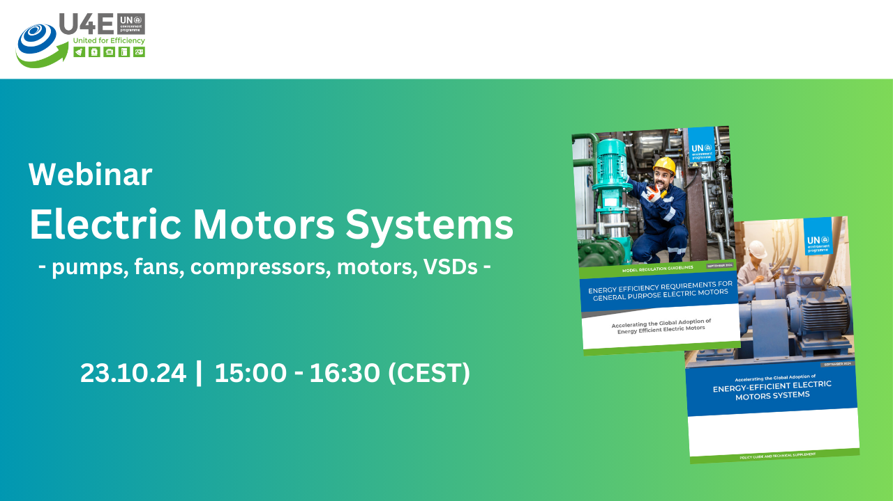


Policies for accelerating the global adoption of efficient electric motor systems
Supporting developing countries and emerging economies on energy efficiency policies and regulations for electric motor systems
Webinar, 23 October 2024
Maarten van Werkhoven, TPA advisors, The Netherlands
mvanwerkhoven@tpabv.nl
Ajit Advani, International Copper Association, India
ajit.advani@internationalcopper.org

Slide 2
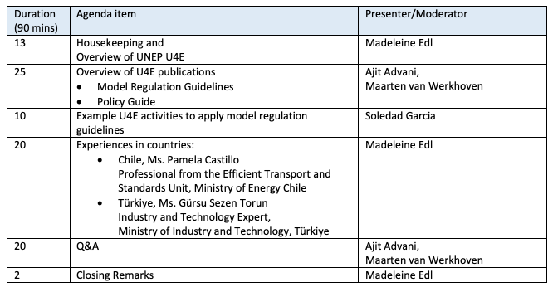
Agenda

Slide 3
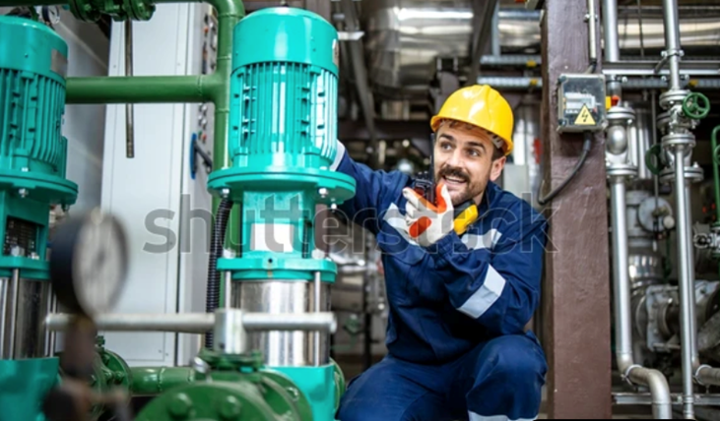

Overview of U4E publications on electric motor systems
Policy Guide
Model Regulation Guidelines
Ajit Advani, ajit.advani@internationalcopper.org
Maarten van Werkhoven, mvanwerkhoven@tpabv.nl
23 October 2024

Slide 4
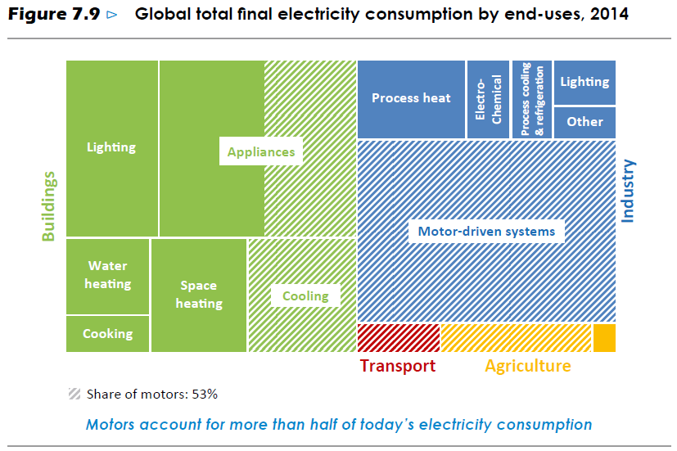
Electricity use – share by electric motor systems
Global total final electricity consumption by end-uses
Motors (systems) represent 74% of electricity consumption in industry
Source: IEA World Energy Outlook, 2019
Motors (systems) are mainly used in industry, large buildings and infrastructure systems. Also transport, agriculture and household appliances include motors.

Slide 5
Electric Motor Systems have the largest CO₂ mitigation potential of all appliance groups
IEA projects that global electricity use in Electric Motor Systems is to rise 25% - 30% by 2030 over 2021.
  Electricity use in 2021 was 12,400 TWh giving rise to to 6.5 Gt of CO₂ emissions
  70% - 80% growth will come from China, India and other emerging markets and developing economies.
CLASP modelling shows that policy actions to
  double the efficiency of new industrial motor systems; and
  greatly accelerate the replacement of existing industrial motor systems stock
  could mitigate 3.4 Gt CO2 emissions by 2040 and 5.1 Gt by 2050.This is more than the combined potential of all other appliance groups
Notes:
IEA projects the global electricity demand to rise by 25% to 30% by 2030 (relative to 2021), due to an increase in motor systems in industry and buildings, a shift to the use of electric heat pumps, and an increased use of electric vehicles and hydrogen (production).
Main growth contribution i.e., 70% to 80%, will come from China, India and other emerging markets and developing economies.
CLASP reports: policy actions to double the efficiency of new industrial motor systems and greatly accelerate the replacement of existing industrial motor systems stock by 2030 could mitigate 3.4 Gt CO2 emissions by 2040 and 5.1 Gt by 2050.
[A doubling of efficiency would mean a 50% reduction in the average energy consumption of new units.] [6.2 Gt in 2021]

Slide 6
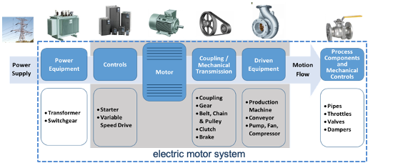
1. Energy savings in Electric Motor Systems will come from improvement of component efficiency + optimisation
U4E Webinar on Electric Motor Systems 2024

Slide 7
The Opportunity and the Challenge for EMDE*
Market transformation policies exist in 56 countries.
Global best practices available.
Rest, largely emerging markets and developing economies need to act
    Lack of technical capacities, know-how and financial means are a constraint in most cases
Risks of inaction
    Ready markets for inefficient products not wanted elsewhere
    Lock-in of inefficiency (motor lifetime > 20 years)
* Emerging Markets and Developing Economies
U4E Webinar on Electric Motor Systems 2024

Slide 8
U4E Policy Guide Electric Motor Systems
  Single-stop reference source for EMDE* policymakers.
  Scope: LV Motors, VSD’s, Fans, Pumps, Compressors + System Optimisation
  U4E Integrated Policy Approach.
  Differentiated Policy Approaches for the New Equipment Market and the Installed Base
  Overview of available resources, tools and best practices globally.
  Technical annex with overview of motor system components, efficiency metrics, terms and concepts.
* Emerging Markets and Developing Economies
8

Slide 9
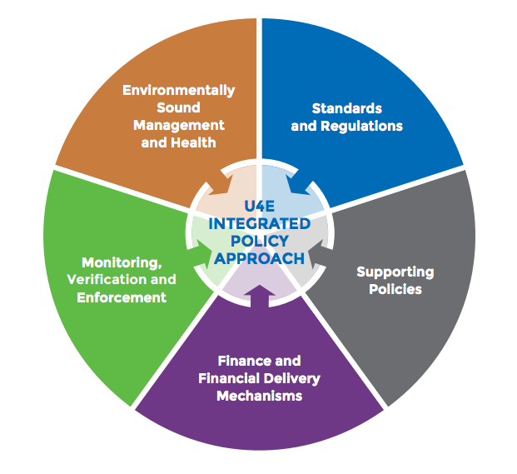
U4E Integrated Policy Approach
U4E Webinar on Electric Motor Systems 2024

Slide 10
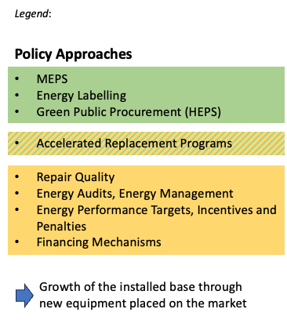
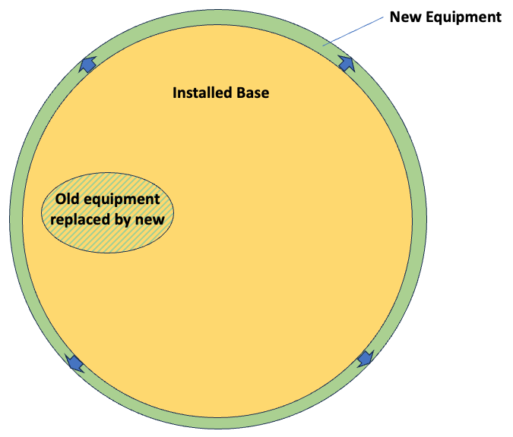
Differentiated Policy Approaches for the New Equipment Market and the Installed Base
U4E Webinar on Electric Motor Systems 2024
10

Slide 11
U4E Motor Systems Policy Guide Application
Facilitate development of vision, policy goals, processes and identify needed resources
Guidance flexible, not prescriptive
All components of Integrated Policy Approach described for completeness
Countries to select based on specific priorities and circumstances
U4E Webinar on Electric Motor Systems 2024

Slide 12
2. U4E Model Regulation Guidelines Electric Motor Systems
  Single-stop reference source for EMDE* regulatory authorities.
  Provides templates for MEPS regulations for
    Electric Induction Motors
    Variable Speed Drives
    Rotodynamic Water pumps and Water pump units
    Fans driven by Motors
    Air compressors
  These include definitions, scope, performance requirements, information requirements, applicable test methods and compliance criteria.
  Structured as building blocks that may be combined based on the market structure and practices in each individual country or region.
* Emerging Markets and Developing Economies
U4E Webinar on Electric Motor Systems 2024

Slide 13
Efficient electric motors –> IE-classification
Source: IEC 60034-30-1

Slide 14
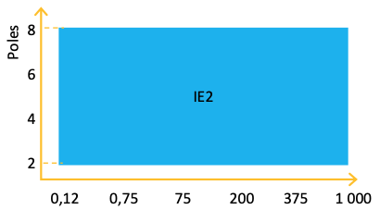
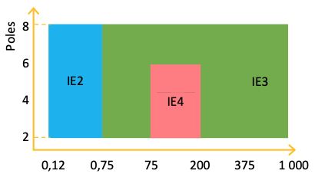
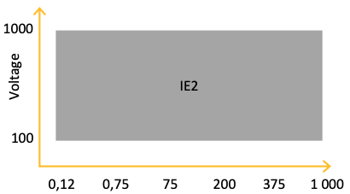

Electric Motors and VSDs – Model Regulation Guidelines
Advanced Level (A), broadest coverage
In line with current international best practice regulations. This is suitable for countries that either do not have a significant domestic motor manufacturing industry, or already have MEPS for motors covering a narrower scope and/or at a lower efficiency level and are ready to adopt the advanced level
Motors rated for operation on 50 Hz, 60 Hz or 50/60 Hz supplies:
- 1-phase motors
- Ex eb motors for explosive atmospheres
3-phase induction motors
2-, 4-, 6-, 8-poles
50, 60 Hz or 50/60 Hz
Rated for continuous duty
motors for explosive atmospheres Ex ec, Ex tb, Ex tc, Ex db, Ex db eb, Ex dc
brake motors, incl. Totally Enclosed Air Over (TEAO) motors
Note: IE4 mandatory for 2-, 4- and 6-poles single speed motors which are not brake motors, Ex eb motors for explosive atmospheres or other explosion-protected motors
3-phase variable speed drives
from 0,12 kW ≤ Pn ≤ 1 000 kW
Major exemptions:
Regenerative drives (active front end, AFE)
Low-harmonic drives (THD < 10%)
Multiple AC-output drives
1-phase drives
U4E Webinar on Electric Motor Systems 2024
14
Notes:
9% savings in total electricity use electric MOTORS in 25 years time

Slide 15
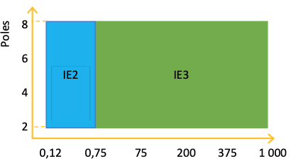
Electric Motors and VSDs – Model Regulation Guidelines
Bridging Starting Level (B), at IE3-level
Countries that do have a significant domestic motor manufacturing industry can choose to start at IE3-level “premium energy-efficiency” for a basic range of 0.75 – 1,000 kW for three-phase motors.
3-phase induction motors
single speed
2-, 4-, 6-, 8-poles
50, 60 Hz or 50/60 Hz
Rated for continuous duty
Major exemptions:
motors for explosive atmospheres Ex ec, Ex tb, Ex tc, Ex db, Ex db eb, Ex dc, nor Ex eb
brake motors, incl. Totally Enclosed Air Over (TEAO) motors
U4E Webinar on Electric Motor Systems 2024
15

Slide 16
Electric Motors and VSDs – Model Regulation Guidelines
Bridging Starting Level (C), with limited time at IE2-level and transitioning to IE3-level
Alternative for countries with a significant domestic motor manufacturing industry;
A more gradual transition by starting at IE2-level “high energy-efficiency”;
Provides a (limited) transitory time for upgrading technology; with the objective of transitioning in steps to Level B and Level A eventually.
3-phase induction motors
single speed
2-, 4-, 6-, 8-poles
50, 60 Hz or 50/60 Hz
Rated for continuous duty
U4E Webinar on Electric Motor Systems 2024
16

Slide 17
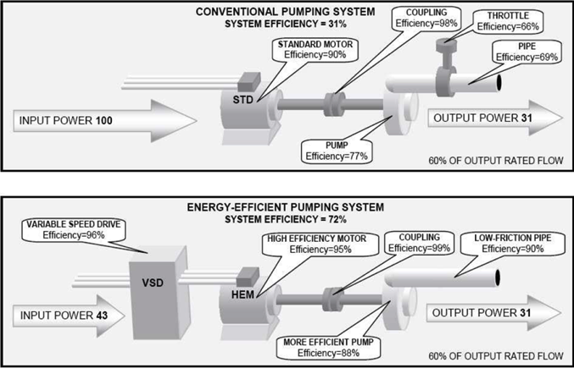
Efficient water pumps –> efficient components
Doubling system efficiency
-> 31%
-> 72%

Slide 18
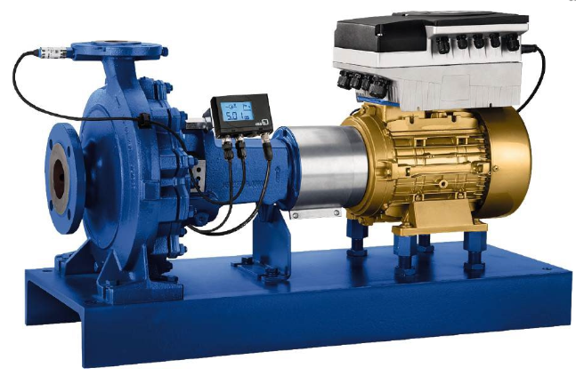
Pumps – Model Regulation Guidelines
Rotodynamic pumps for clean water
  End suction own bearing (ESOB), End suction close coupled (ESCC), End suction close coupled inline (ESCCi)
  Vertical multistage (MS-V), Horizontal multistage (MS-H), Submersible multistage (MSS) and
  Booster sets (BS)
Advanced Level (A)
Start directly at the current international best practice level. The efficiency levels include
- for water pumps a Minimum Efficiency Index of 0.4 (MEI), and
- for water pump units - for ESOB, ESCC and ESCCi end suction units up to 45 kW shaft power an Energy Efficiency Index of not more than 0.62 (EEI), and for booster sets an Energy Efficiency Index of not more than 0.5 (EEI).
Bridging starting level (B)
Optional bridging level: a lower Minimum Efficiency Index for pumps only (the hydraulic efficiency) of MEI = 0.1 providing domestic manufacturers a (limited) transitory time for upgrading technology. These exclude the booster sets.
Notes:
22% savings in total electricity use WATER pumps in 25 years time

Slide 19
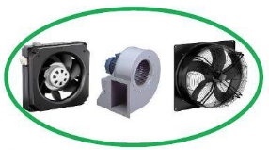
Fans – Model Regulation Guidelines
Five different fan types i.e., axial fans, centrifugal fans, cross flow fans, mixed flow fans and jet fans, with an electric input power between 125 W and 500 kW, at one of the following levels:
Advanced Level (A)
Offers a regulatory framework designed to leapfrog directly to the best practice advanced level in line with current international best practice regulations.
Minimum fan energy efficiencies are defined by an efficiency grade N specific for each fan type. The efficiency grades N are at ‘premium level’, ranging from N50 to N67 and include information requirements on partial load.
Bridging Starting Level (B)
The bridging level includes lower efficiency grades providing domestic manufacturers a (limited) transitory time for upgrading technology. The efficiency grades N range from N45 to N65.
Notes:
25% savings in total electricity use FANS in 25 years time

Slide 20
5. Key recommendations (1/2)
Develop and implement a national strategy for efficient electric motor systems
where an economic and environmental impact analysis will provide the principal basis for determining the scope and level of electric motor systems regulations
starting with motors and extending in an appropriate timeline to efficient pumps, fans, compressors and variable speed drives.
Leapfrog directly to the Advanced Level options
or choose to start at Bridging Levels to accommodate domestic manufacturers with a transitory period
Collaborate with other countries in the region
to harmonise standards according to international best practices and to share resources and lessons learned
Aim to implement a MVE (monitoring, verification and enforcement) regime
within the national legal framework in time
to coincide with the adoption of MEPS and
to ensure accurate and reliable measurement of the energy efficiency of motor system components

Slide 21
5. Key recommendations (1/2)
Use voluntary supporting policies e.g.
communication campaigns to educate, inform and build capacities;
to improve energy management practices at the government, company, and industry level;
to pull the market for new equipment above MEPS e.g. through Labelling and Green Public Procurement;
to accelerate the renovation of inefficient motor systems in the installed base;
to improve repair practices and to adopt best practices in shops to yield professional repairs so motors meet their original performance;
Conduct targeted outreach and training to inform, educate, and gain the support of key stakeholders.
Conduct market analysis
to understand financial barriers; bring financial delivery schemes in place to support voluntary actions
Include the subject of circularity
into relevant policies, aiming to minimise the impact on human health and the environment, and reducing waste and environmental impacts, and - ultimately - eliminated through the principles of durability, repairability, reuse, remanufacturing, and recycling.

Slide 22



Contact
TRANSFORMING MARKETS TO ENERGY-EFFICIENT PRODUCTS
PHONE
EMAIL
WEBSITE
+33 1 44 37 19 86
unep-u4e@un.org
united4efficiency.org

