Slide 1


U4E Webinar on Electric Motor Systems
- pumps, fans, compressors, motors, VSDs –
23rd October 2024

Slide 2
Housekeeping
2.
3.
1.
Each participant can enable audio and video. Kindly mute yourself and turn off your video when you enter the webinar.
Please post questions in the chat during the presentations.
Please raise your hand and unmute yourself during the Q&A session.
The session is being recorded and will be posted later on our website, along with the slides.
Thank you for joining! Let’s get started. ☺

Slide 3
Overview of UNEP U4E
Madeleine Edl, Senior Energy Efficiency Expert
23 October 2024

Slide 4













































U4E Partner Organizations
Manufacturers & Industry Associations
Technical Organizations
& Centres
Funders and Financiers
International Organizations & Initiatives

Slide 5
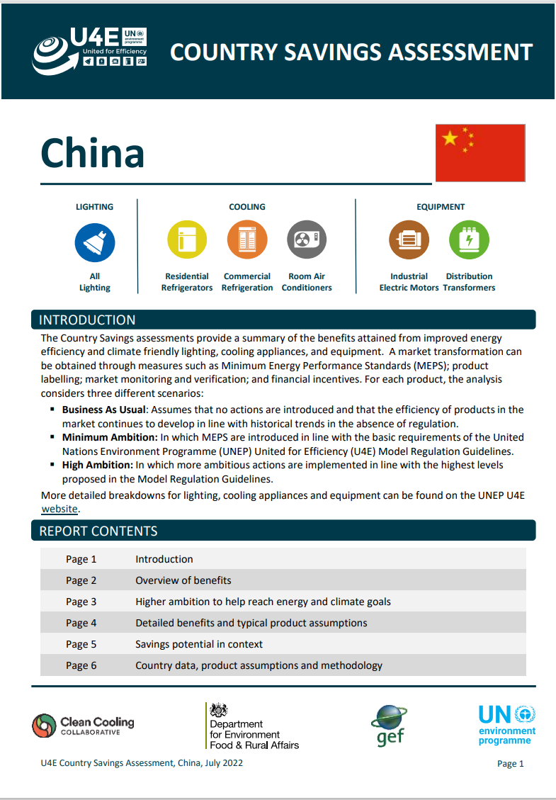


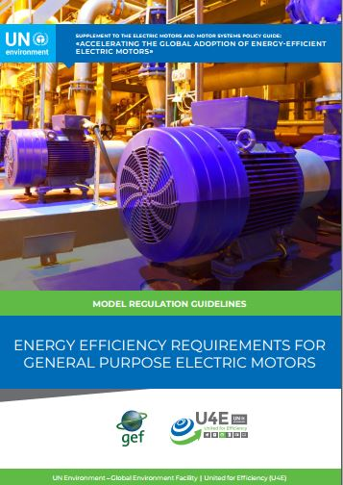
Overview of U4E Tools and Guidance
Resources: U4E website
Updated motors policy guide is available shortly!
Country Savings Assessments
Policy Guides
Technical Guidance
Model Regulations
Why is EE important?
Which products should we prioritise?
Which integrated policies and interventions should be considered? How have others done it?
How to analyze data, test products, enforce regulations?
Which scope, performance, safety, testing, etc. are a good starting point for MEPS & labels?

Slide 6
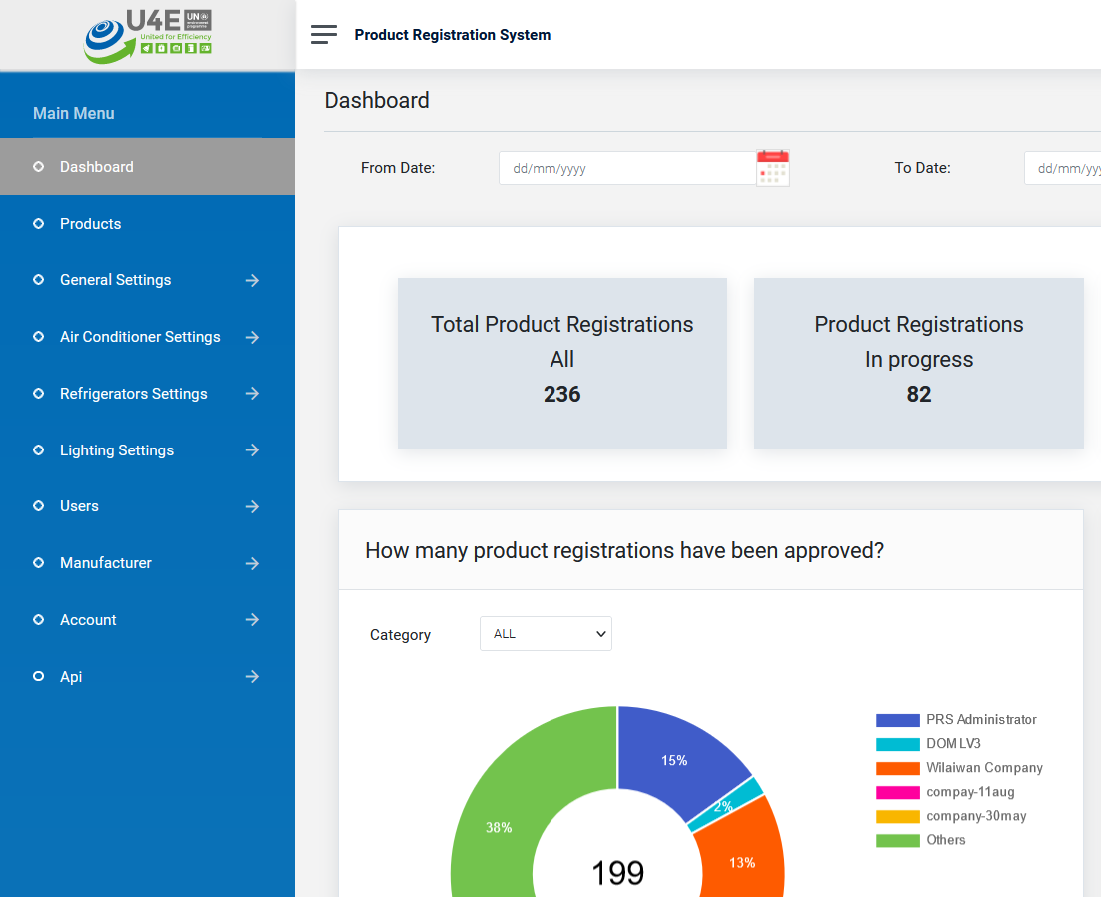
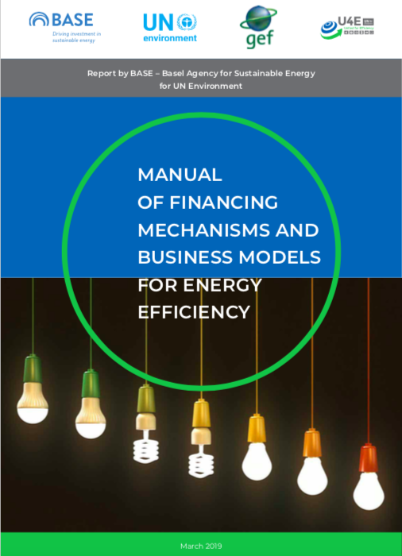

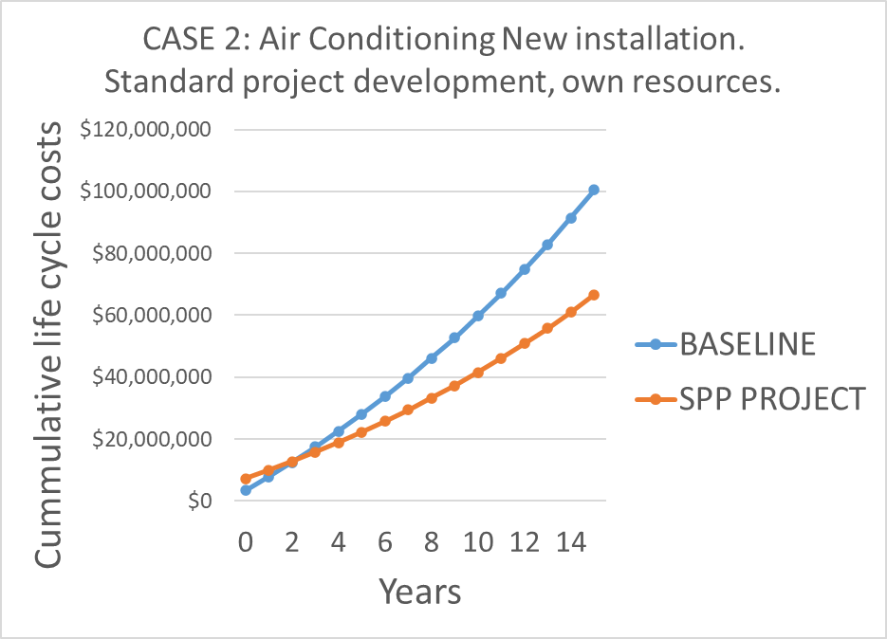
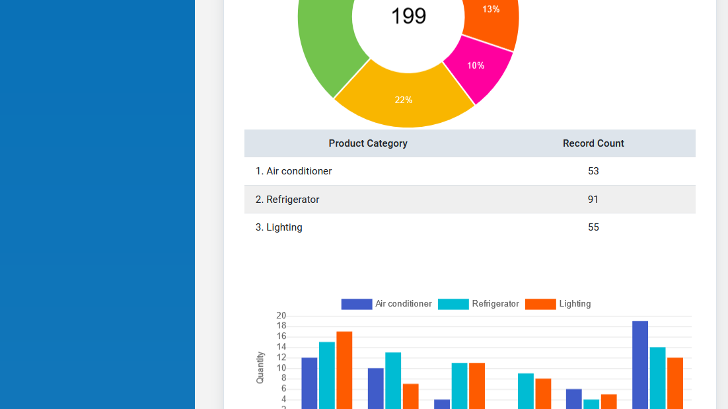
Overview of U4E Tools and Guidance
Resources: U4E website
Sustainable Public Procurement
Product Registration System
Financial Mechanisms
How to monitor the market, enhance enforcement, and share information?
How to address higher first costs, risk, access to capital, & other barriers?
Which products are claimed to meet the Model Regulation Guidelines and where are they available?
How to assess their benefits for end users?

Slide 7
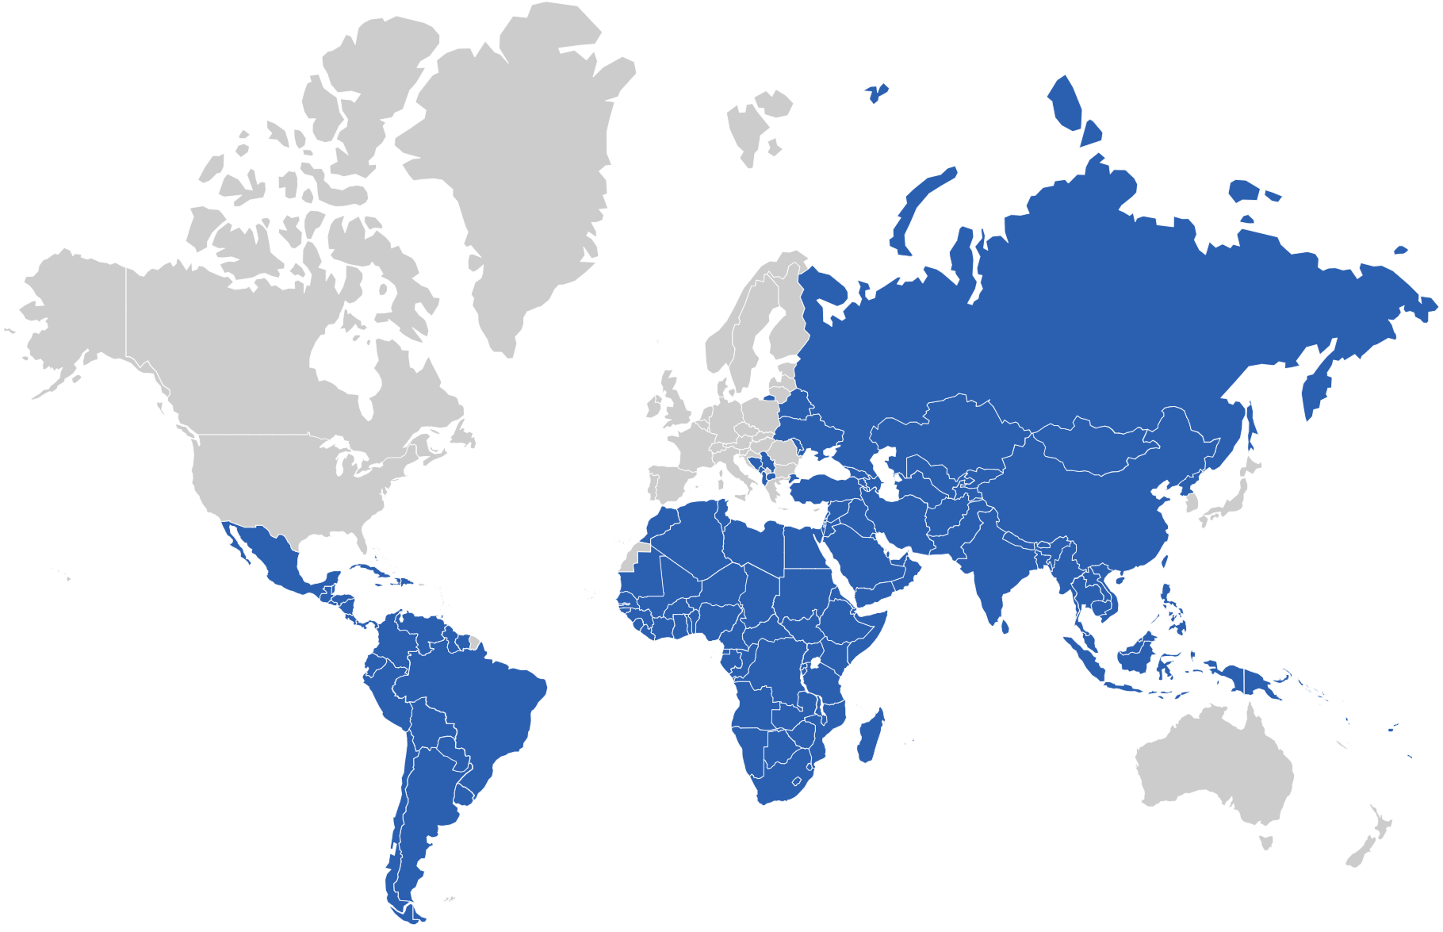






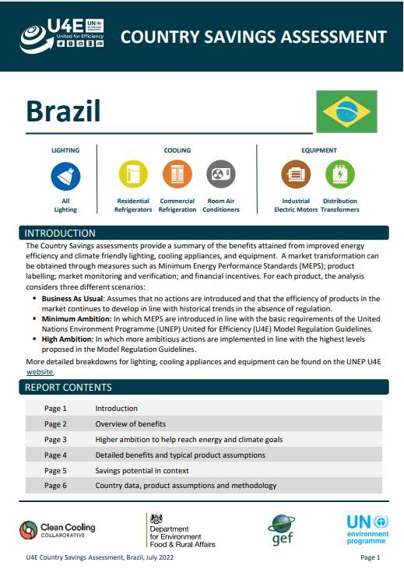
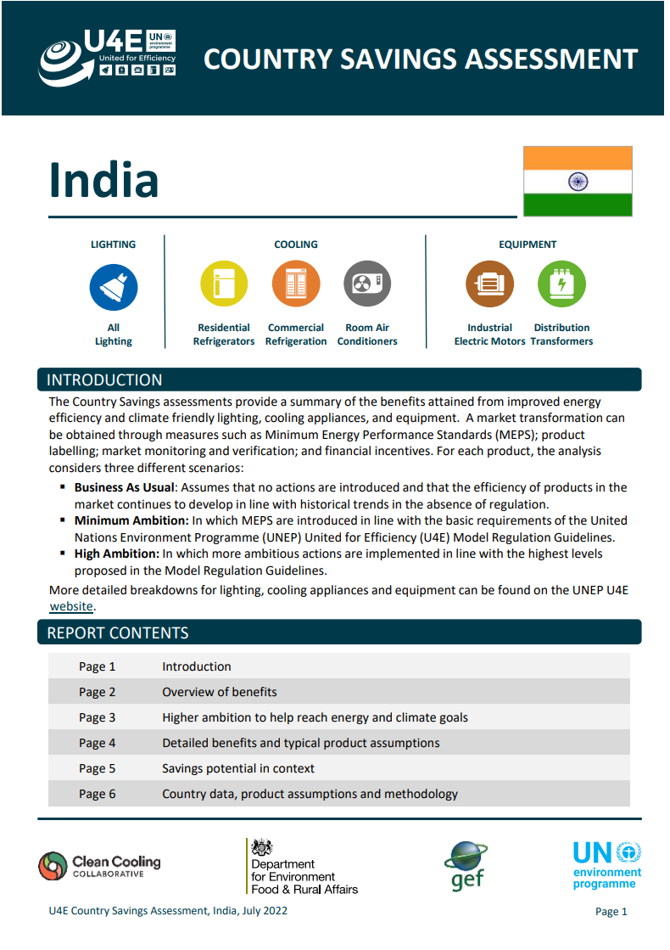
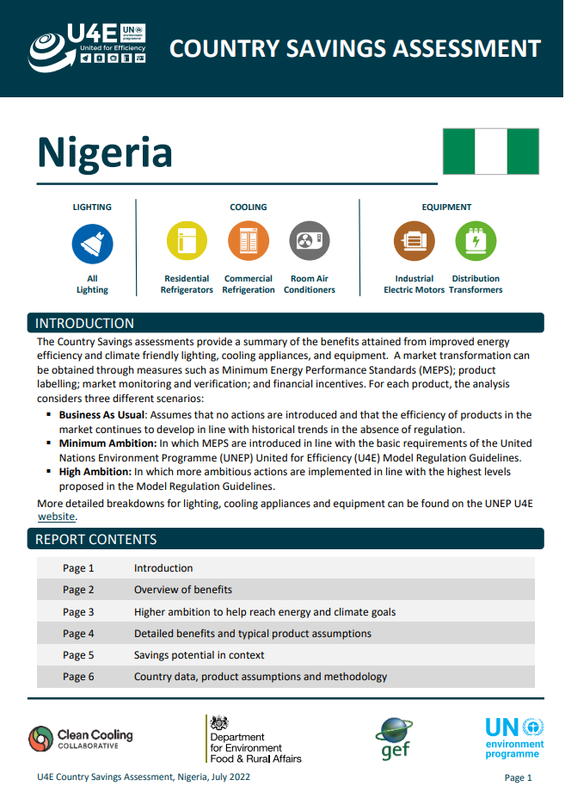

U4E Country Savings Assessment - 2022 Update
156 developing countries and emerging economies have been assessed under the U4E Country Saving Assessments
Explore for each country on: https://united4efficiency.org/countries/country-assessments/
U4E Country Savings Assessments Factsheet is available here
7
Notes:
Please see the united4efficiency.org website for the individual assessment for each country.
The individual assessment includes infographics and graphs, which can assist in prioritizing action on energy-efficiency in your country.

Slide 8
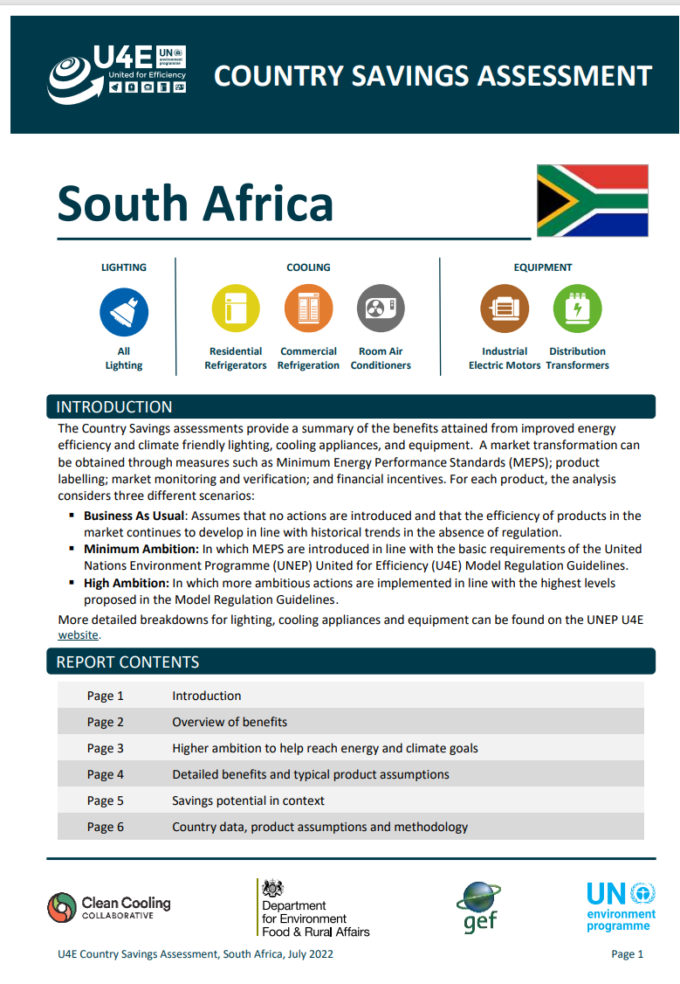
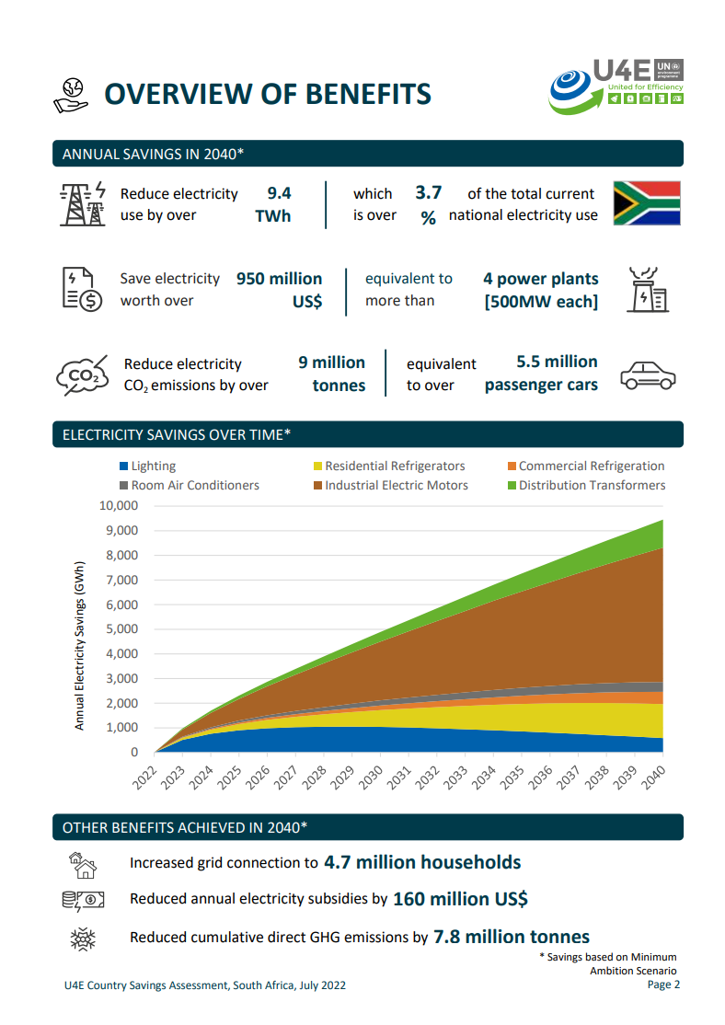
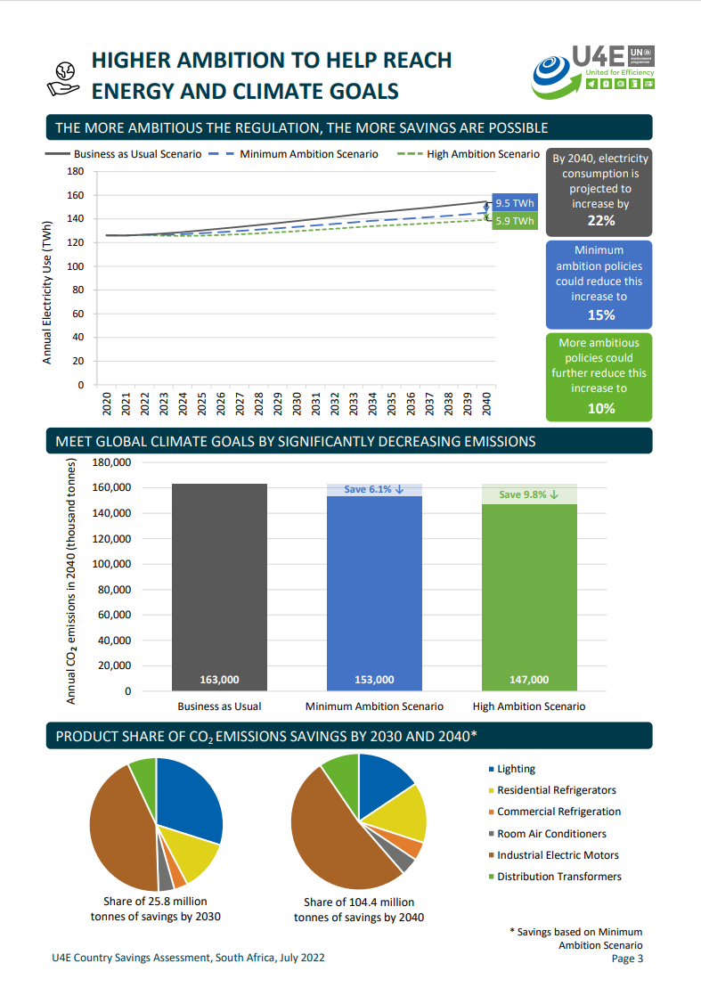

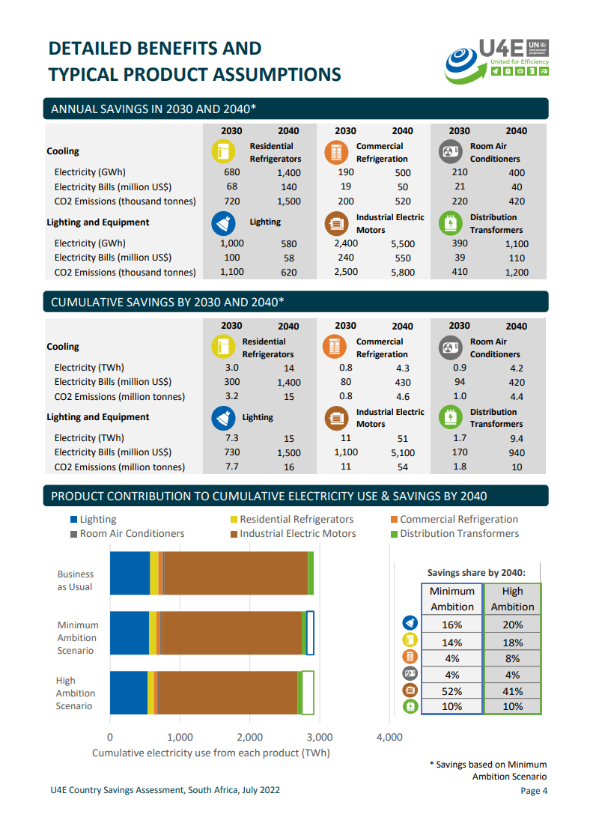
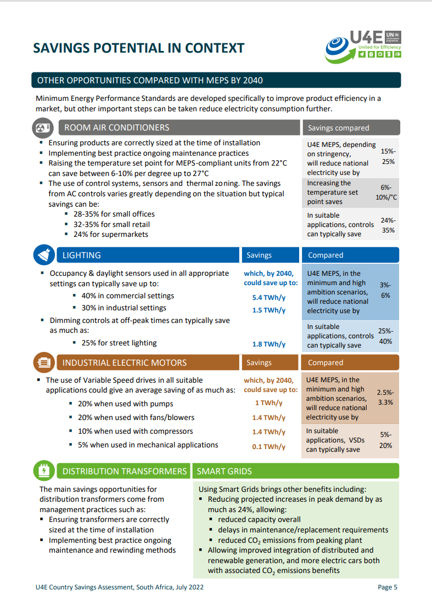
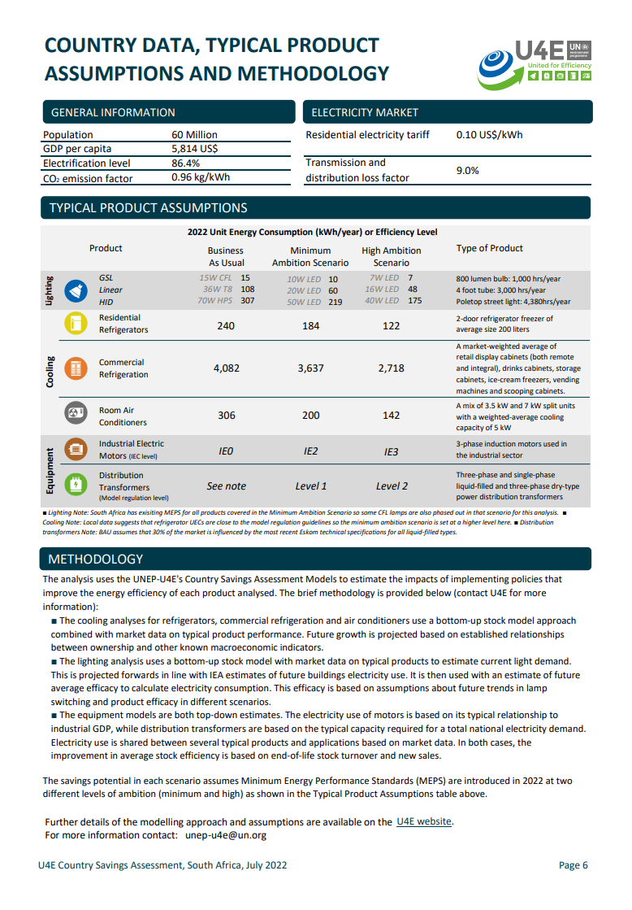

Country Savings Assessments
Objective
Analysis of the potential impact of adopting Model Regulation guidelines for lighting, room air conditioners, residential refrigerators, commercial refrigeration equipment, industrial electric motors, and distribution transformers.
These product categories are responsible for >50% of electricity usage today.
Overview
The assessment provides three scenarios: Business As Usual Scenario (BAU)– No policy intervention; Minimum Ambition Scenario – assumes Minimum Energy Performance Standards (MEPS) implemented; High Ambition Scenario – Assumes MEPS are implemented at a higher level of ambition for six products.
The energy savings potential is calculated till 2040 and is computed based on the difference between total energy consumption in the ambition scenarios and that of the BAU scenario and is expressed in terms of GHG emissions mitigated, Capacity (Power plants) avoidance and Financial savings.
*Available in English for all 156 developing and emerging economies.
French and Spanish translations are available for select countries
Individual country CSA reports can be downloaded from https://united4efficiency.org/countries/country-assessments/
8
Notes:
The CSA serves as a powerful tool by providing tangible (social, economic and environmental) benefits that enable policy makers take informed decisions and prioritizing countries for funding/implementing climate change mitigation projects.

Slide 9
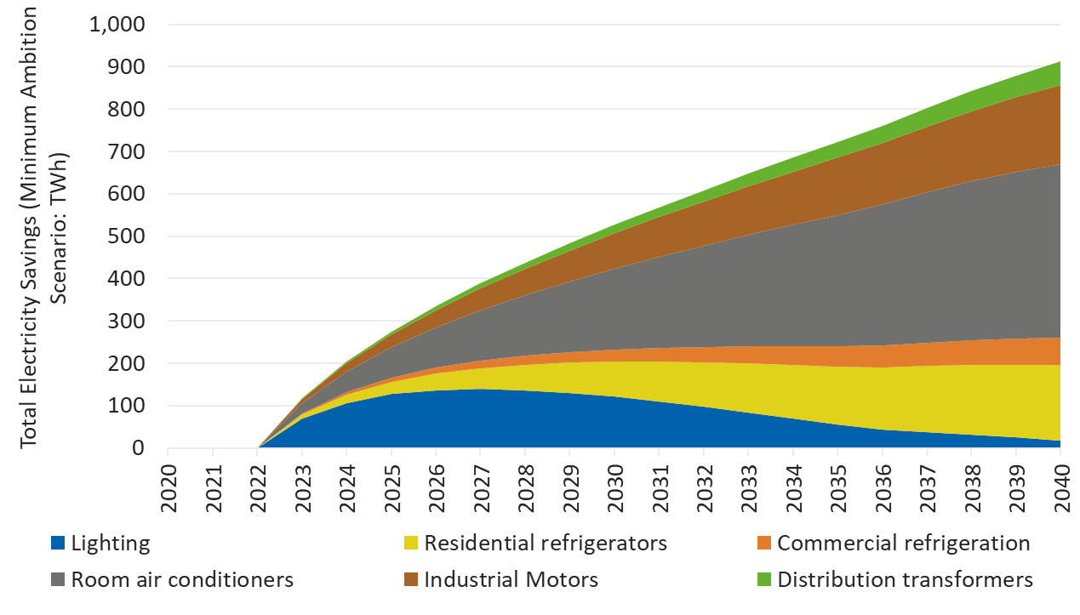




Saving Opportunities in Emerging Economies and Developing Countries for Industrial Motors
Annual savings for industrial electric motors
187*
185
$26
Million tonnes
Billion USD
TWh
Minimum Ambition Scenario
9
Notes:
Countries included (14):
Cook Islands Fiji Kiribati Marshall Islands Micronesia, Fed. Sts. Nauru Niue Palau Papua New Guinea Samoa Solomon Islands Tonga Tuvalu Vanuatu

Slide 10
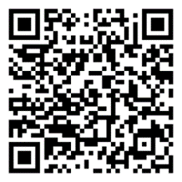
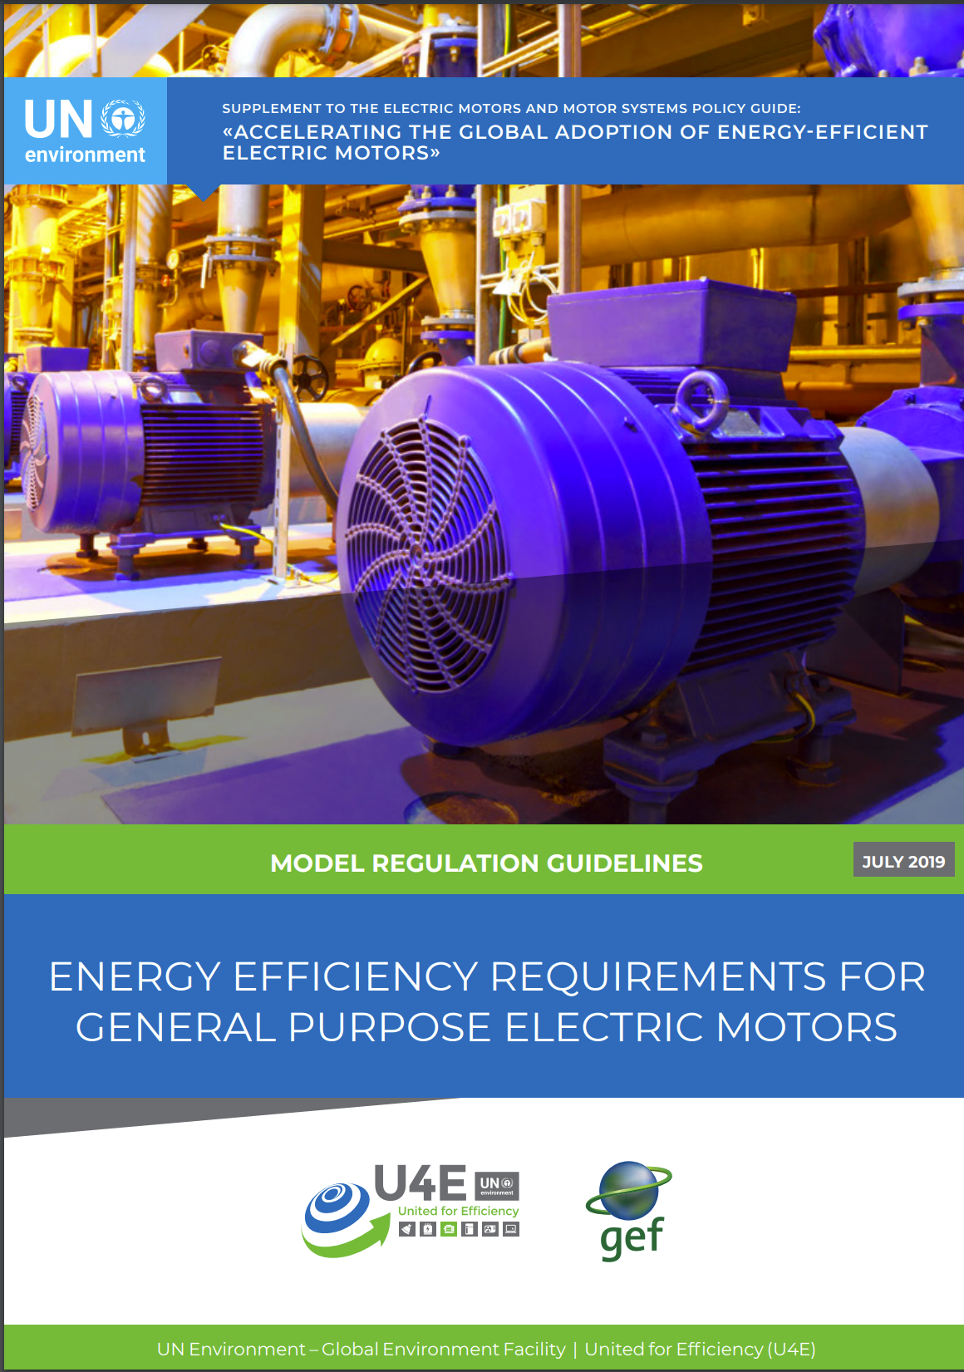
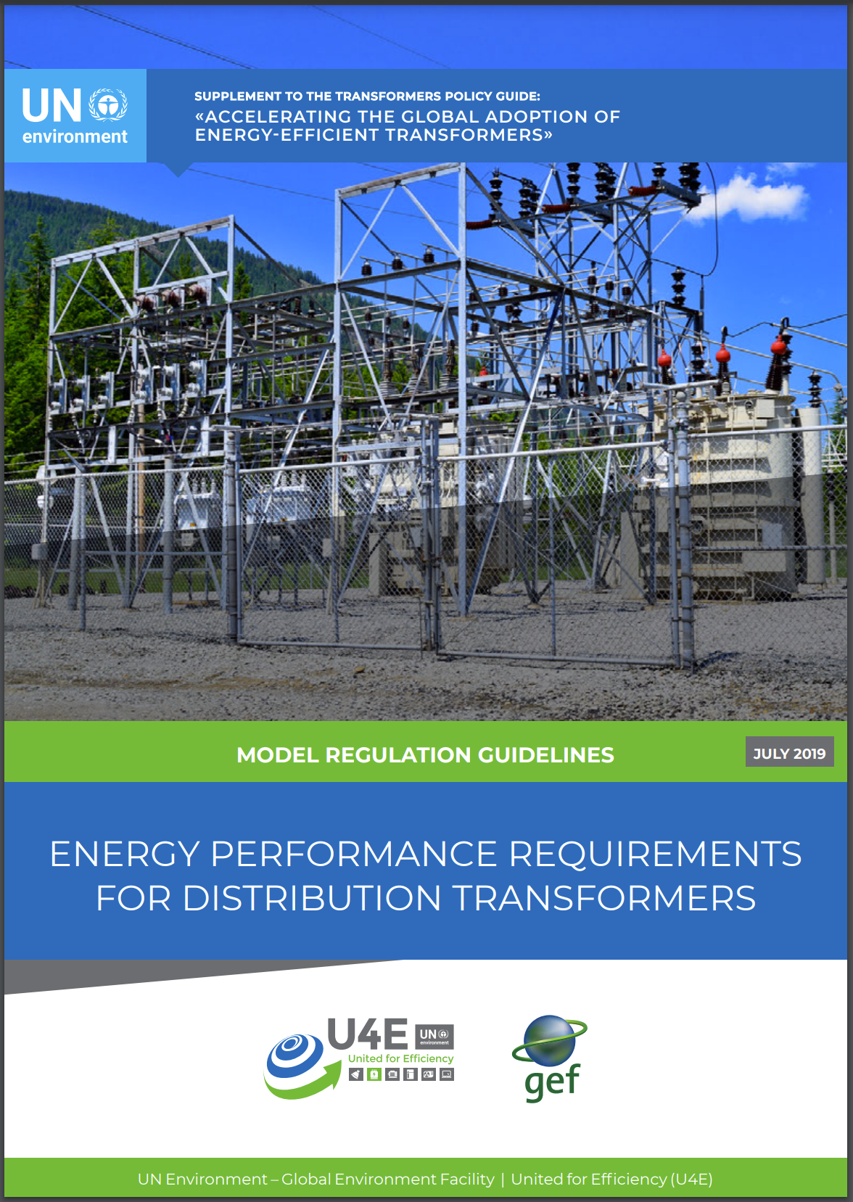
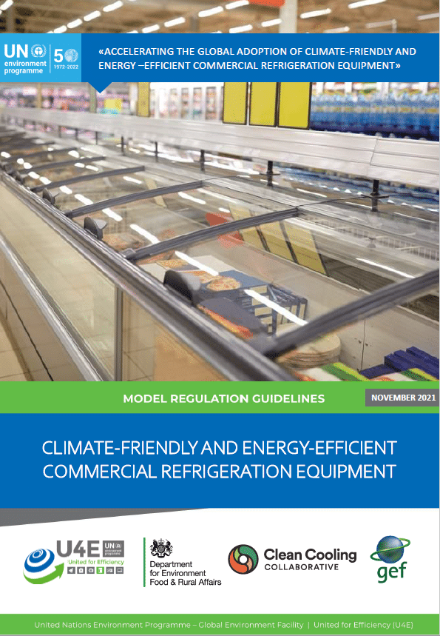
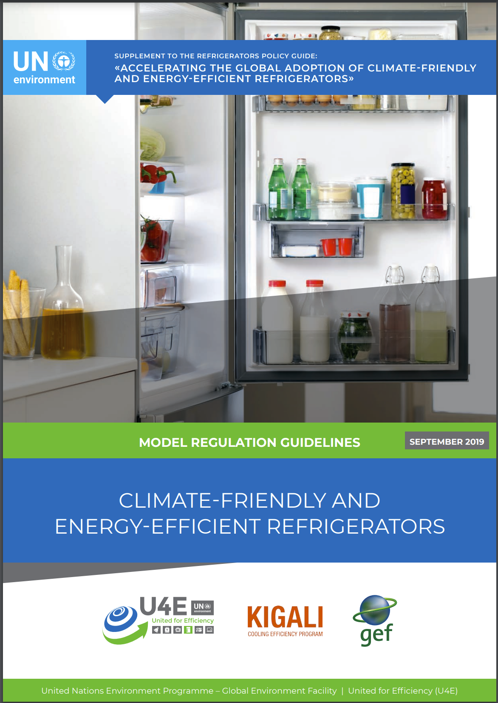
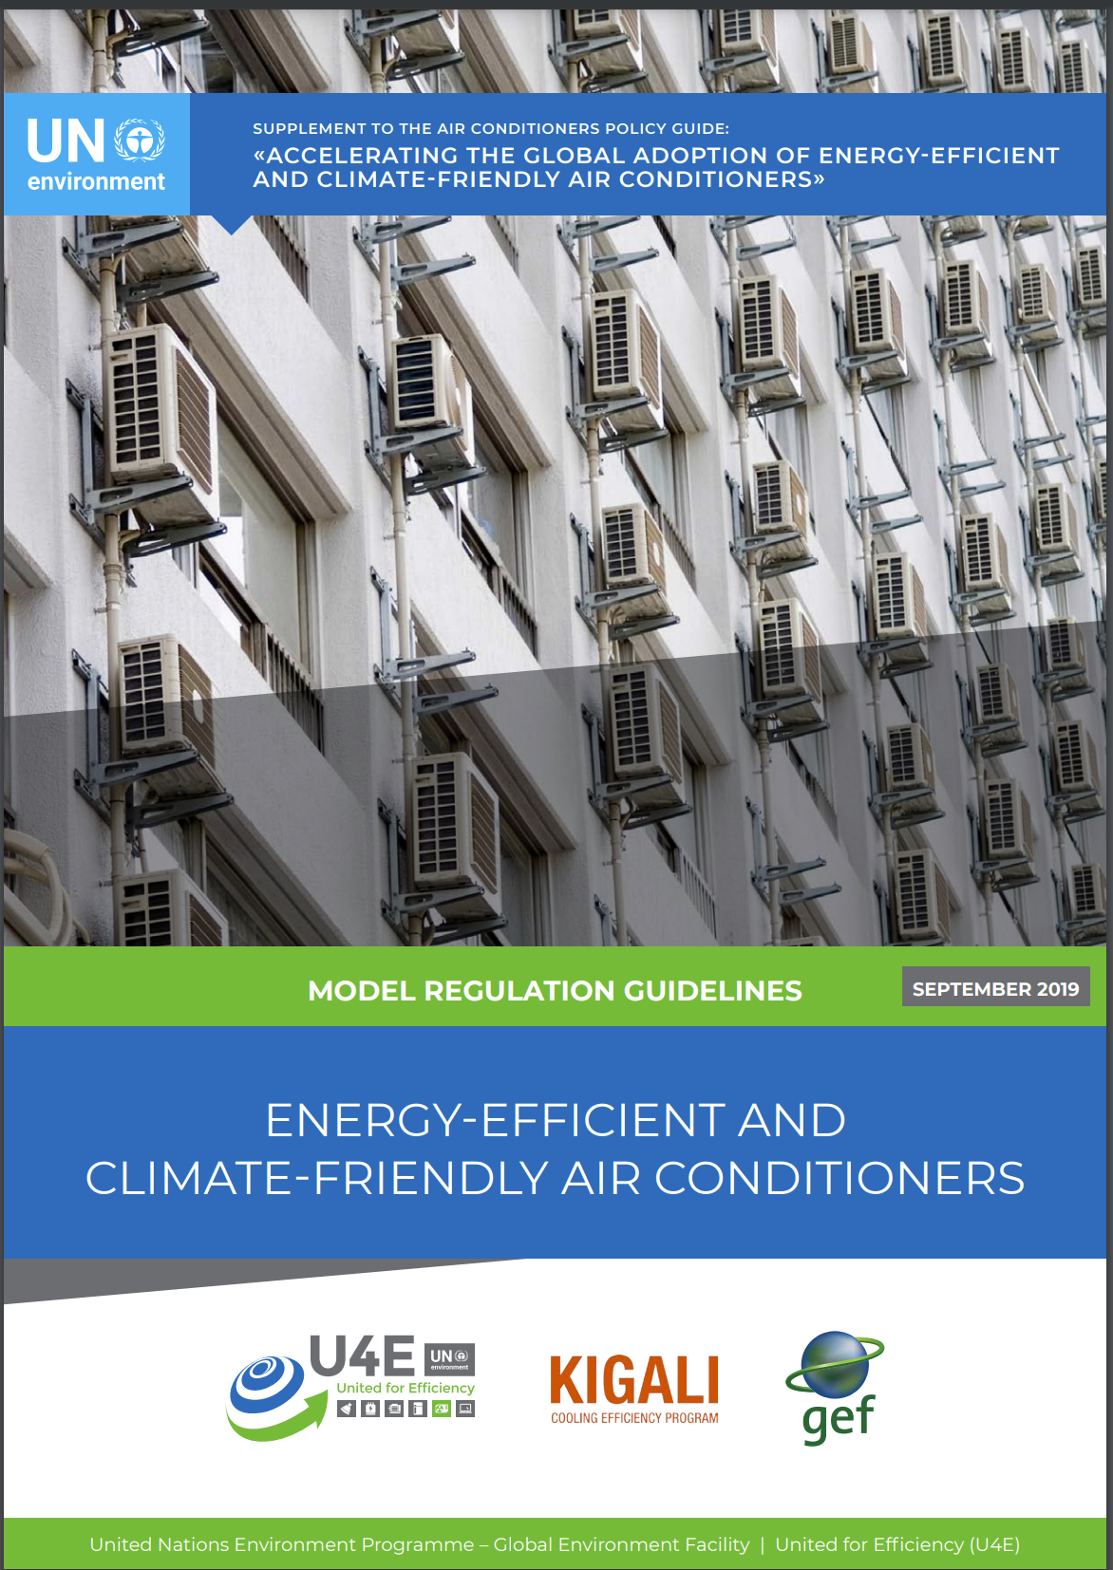




Model Regulation Guidelines
Updated model regulation is available shortly!
Guidance to help inform regulatory authorities and policy makers
Sets a minimum efficiency floor to prohibit future sales of inefficient products from the market and sets higher tiers consistent with technology and market opportunities.
Over 60+ technical experts (per product group) from around the world contributed data, analysis, reviews
Simplify adoption and implementation of a robust regulation
References global technology and policy trends
Equipment
Lighting
Cooling
Cooling
Donors:
Available in English (all); Arabic, Spanish, Chinese, French, Portuguese for select products
Available at: https://united4efficiency.org/resources/model-regulation-guidelines/ or scan the QR above
Available at: https://united4efficiency.org/resources/model-regulation-guidelines/
10

Slide 11
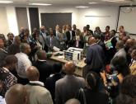
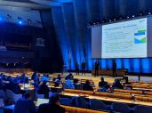



Recent Examples of Opportunities to Apply the Guidelines
Global
  Global Cooling Pledge - COP28 Presidency supported by Cool Coalition
  Kigali Implementation Plans to increase equipment efficiency
  Reference for efficiency benchmark in partner guidance: CLASP Best World MEPS, IEA 4E programme, IDBs programme eligibility, GIZ NDC4 proposal eligibility criteria
  Cool Coalition National Cooling Action Plan methodology
  Climate Commitments NDC on updating existing MEPS and labels
  Capacity Building: Green Cooling Summit, Twining Workshops
National Projects
  MEPS & Labels: Rwanda (adopted), Pakistan, Brazil and Chile (commercial refrigerators under discussion)
  GCF Readiness (The Gambia), Update existing MEPS & Labels in Cuba, El Salvador, and Honduras
  Recommended in NCAPs (incl. Nigeria, Barbados, Dom Republic, Kenya)
  Financial Mechanisms: Ghana, Senegal, Rwanda, Costa Rica; SPP schemes in pilot countries in 2021 Sustainable Public Procurement: Toolkit and pilots in Morocco, Ghana and possibly Egypt
Regional Harmonisation
  MEPS & Labels: ASEAN; East Africa; Southern Africa
11
Notes:
Several Ongoing.. Nigeria, LAC, etc.

Slide 12



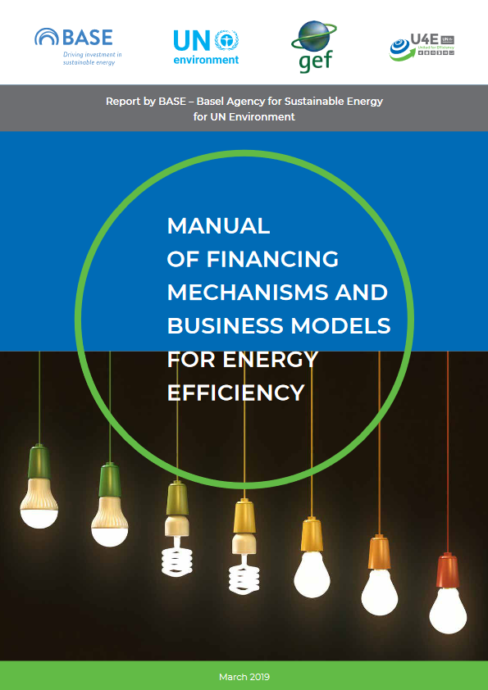
U4E Complementary tools to the Model Regulation Guidelines
Market and Impact Assessments
Labels Guidance
Compliance Mechanisms
Incentive Programmes
12

Slide 13

Examples of U4E project implementation

Slide 14




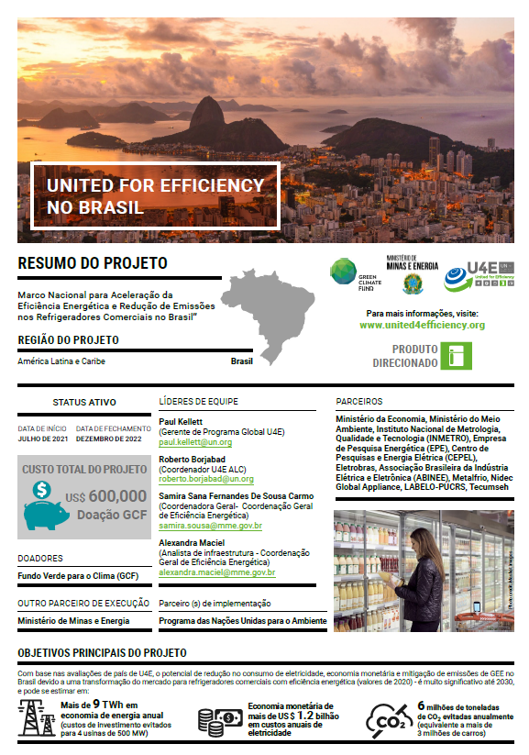
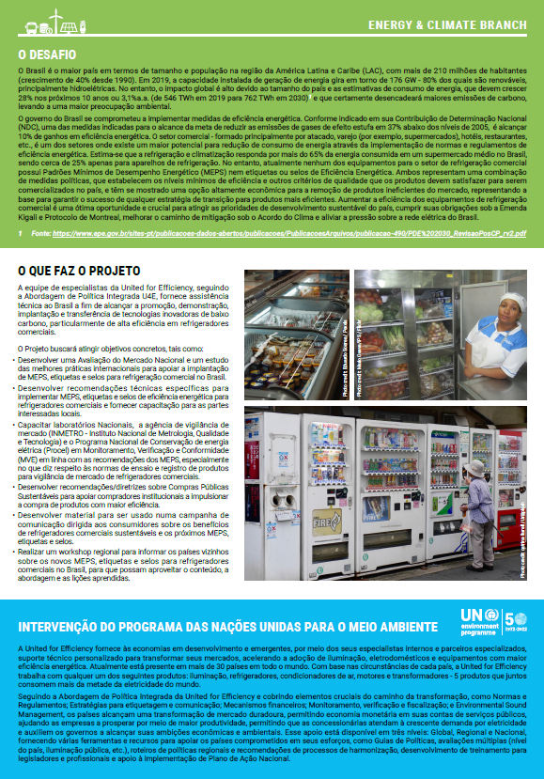
National and Regional Project Examples
Energy Efficiency Commercial Refrigerators in Brazil
Main components
Market Assessment on commercial refrigerators.
Recommendations on international best practices to implement Minimum Energy Performance Standards and Labelling regulation for commercial refrigerators (Refrigerated display cabinets, Ice-cream freezers, Beverage coolers).
Develop monitoring, verification and compliance (MVE) capabilities for commercial refrigerators, including an overseas Study Tour on Testing Standards for National laboratories and local manufactures.
Technical assistance for the development of Product Registry System for Commercial Refrigerators.
Recommendations/guidelines on Sustainable Public Procurement.
Regional workshop to share recommendations and lessons learned with other MERCOSUR countries.
Q3 2021
–
Q4 2022
Donor:
Partners:

Slide 15
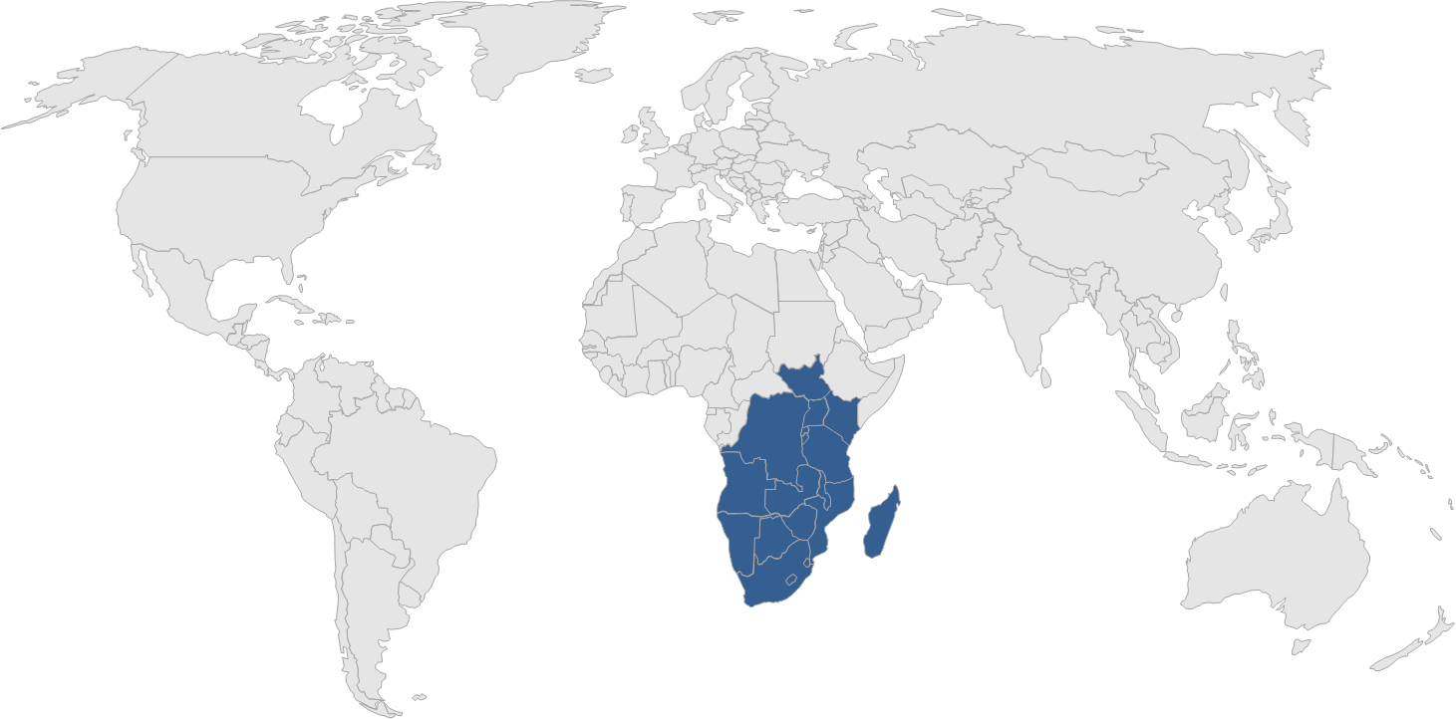


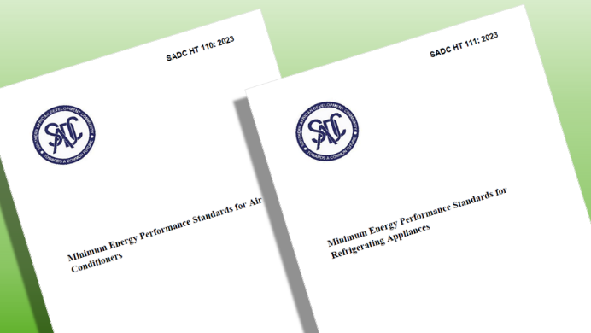



National and Regional Project Examples
Regional Harmonization and National Implementation in SADC and EAC
Main components
Development of regionally harmonized Minimum Energy Performance Standards and Labelling for the East African Community (EAC) and Southern African Development Community (SADC) → Total of 21 countries (16 SADC & 6 EAC).
Facilitate stakeholder engagements including technical committee meetings and public enquiry.
National adoption (on a voluntary basis) of the MEPS by 4 country members (Eswatini, Mozambique, Zambia, and Zimbabwe)
Public awareness activities including preparation of public sensitisation materials.
Capacity building for customs agencies, standards organizations, and other important stakeholders
Q1 2022 – Q4 2024
Donor:
Partners:

Slide 16



Contact
TRANSFORMING MARKETS TO ENERGY-EFFICIENT PRODUCTS
PHONE
EMAIL
WEBSITE
+33 1 44 37 19 86
unep-u4e@un.org
united4efficiency.org

