Slide 1



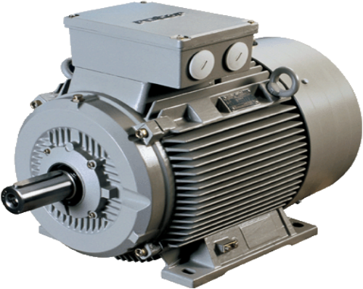
PROMOTING ENERGY EFFICIENT MOTORS
IN SMALL AND MEDIUM SIZED ENTERPRISES IN TÜRKİYE- TEVMOT
Dr. Gürsu Sezen TORUN
Industry and Technology Expert
MINISTRY of INDUSTRY and TECHNOLOGY, TÜRKİYE
sanayi.gov.tr

Slide 2
Content
TEVMOT Project
- Objective and Components -
Lessons Learned
Electric Motors in Türkiye
Pilot Motor Replacement Program
- Field Observations and Success Stories -

Slide 3
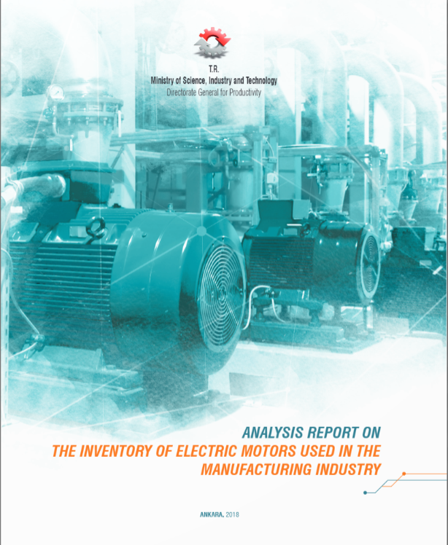
Analysis Report on the Inventory of Electric Motors used in Turkish Manufacturing Industry- 2016
Electric Motors in Turkiye
Electric motors according to their power range and efficiency class
          There are a total of 3,783,694 AC motors with a power rating of 7.5 kW and above currently used in industry and are low efficient (IE0, IE1, IE2 without variable speed drive).
          34 billion kWh electricity (around USD 4 million) will be saved annually if all the 7.5 kW and above AC asynchronous low efficient motors (3,783,694) are replaced.

Slide 4



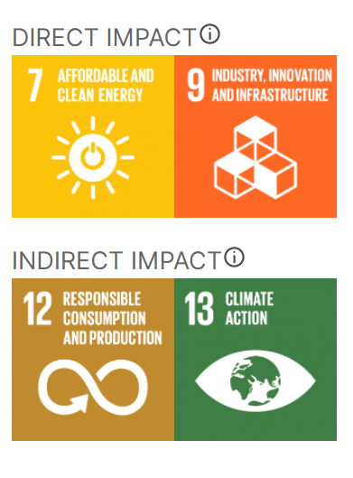

Promoting Energy Efficient Motors in SMEs in Türkiye- TEVMOT
  The project aims to promote significant additional investment in industrial energy efficiency in Türkiye by transforming the market for energy efficient motors used in small and medium sized enterprises.
Objective
Displacement of existing low efficient motors with efficient ones in SMEs
Maintaining new efficient motors’ penetration into the market
Local Import
Start to exchange
Transforming the market for EE motors
Market Transformation

Slide 5













TEVMOT- Project Components
Strengthening regulatory framework for both existing and manufactured electric motors
Development of both management and information infrastructure
Improvement of the capacity of TSE (Turkish Standards Institute) Motor Test Laboratory
Development of Financial Support Mechanism
Awareness raising campaigns and training programs
Pilot motor replacement
Donor
Implementing Partners
Partners

Slide 6
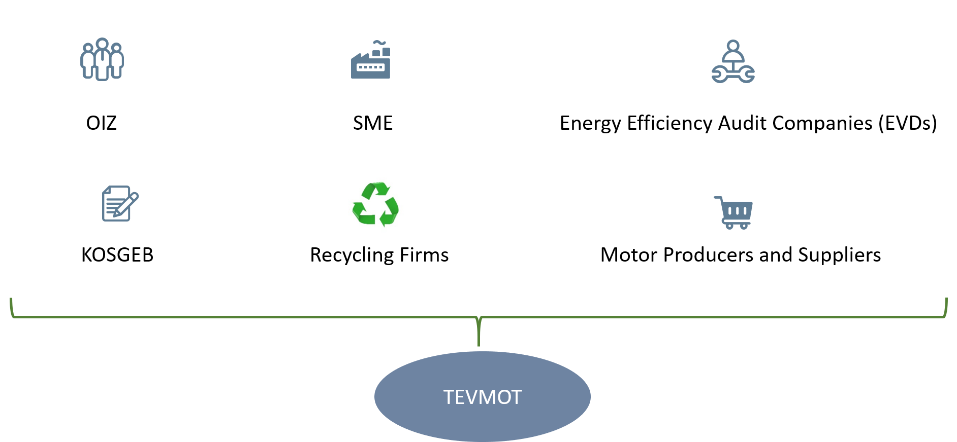
Pilot Motor Replacement Program- 2020-2022
  Financial mechanism to support SMEs for the motor replacement has been developed with KOSGEB (Small and Medium Enterprises Development Organization of Türkiye)
  For the 2 years’ time period through grant support for 7 pilot OIZ
  Upper limit per SME is about 10.000 US$
  The recycling program for the inefficient electric motors replaced was developed.
Partners in Pilot Program
Notes:
Financial mechanism to support SMEs for the motor replacement has been developed with KOSGEB (Small and Medium Enterprises Development Organization of Türkiye) for the 2 years’ time period through grant support for 7 pilot OIZ.
Upper limit per SME is about 10.000 US$
The recycling program for the inefficient electric motors replaced was developed and is operating in 7 pilot OIZs to transform the market to the high efficient electric motors.

Slide 7
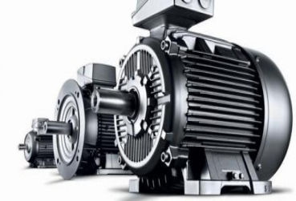


Summary of the Pilot Motor Replacement Program
Walk-through and Detailed Energy Audits
Motor Replacement
One to One Meetings
92 KOBİ
48 SMEs
363 motor
100 SME
Detailed Energy Audits
94 SME
achieving about 1.493.321 kWh/year energy savings and 685 tons of CO₂-eq reductions
annually
Cooperation with KOSGEB
Budget
(Energy Audits + Motor Replacement)
TEVMOT Audit Contribution, $111.250, 100%

Slide 8
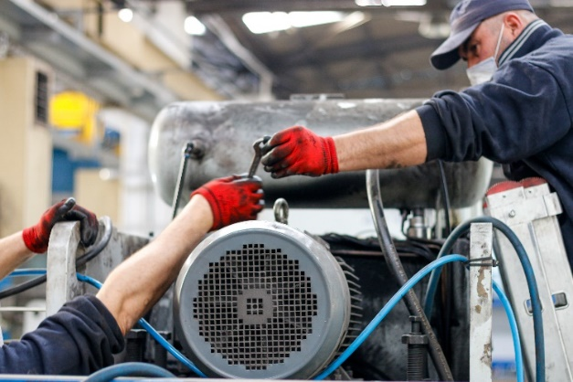
Pilot Program- Field Observations
Primary Barriers Towards Expanding Energy-Efficient Electric Motors
Low awareness level
  Limited awareness of SMEs to the benefits of EE motor investments,
  Limited technical capacities of SMEs to energy auditing and assessments
  Industrialists are more conservative against cost- increasing variables
  Reluctance to change a working process.
Lack of liquidity / financing
  Industrial SME unwillingness to pay up front costs of an EE motor investment,
  Lack of SME incentive to access available financial products, and
Inaccessible EVD / ESCO support
  Lack of available external experts who can provide cost effective motor replacement plan for industrial SMEs.

Slide 9
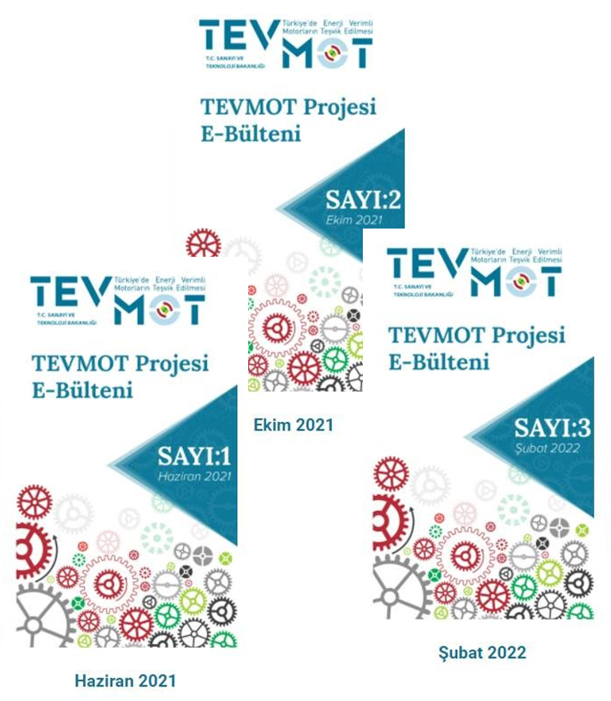
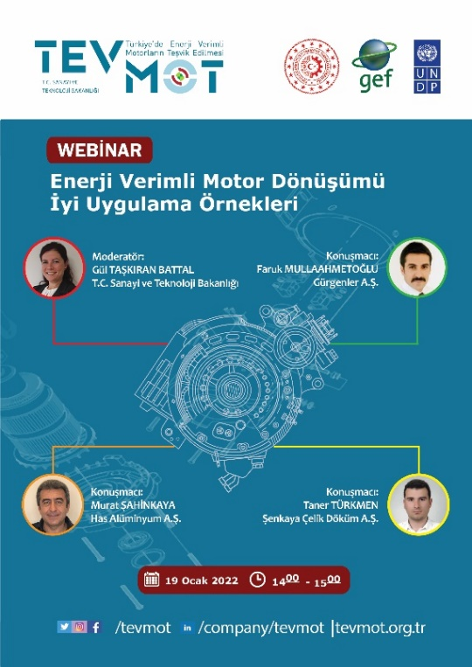


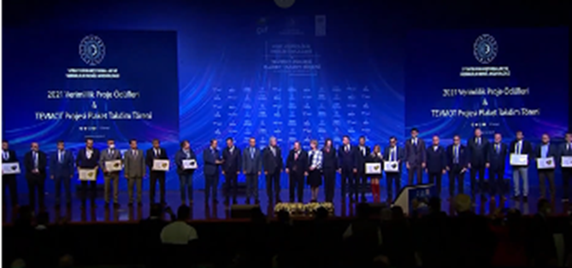

Awareness Raising - Visibility
E-bulletins
EE Motor Replacement Best Practices Webinar
Turkish version of EMSA Guide
Recycling Guide for Industrial SMEs
Award ceremony of beneficiary SMEs, December 2021
Notes:
Also, success stories of SMEs are produced and available in TEVMOT Youtube Channel and other project social media channels.

Slide 10


TEVMOT’s Contribution to Global Energy Efficiency Efforts
CO₂ Emissions & Energy Savings
Energy-Efficient Motors for SMEs
TEVMOT
Market Transformation & Financial Support
Updated Policy Guidelines (Aligned with U4E)
Notes:
TEVMOT's focus on energy-efficient motors for SMEs.
Alignment with updated policy guidelines of U4E.
Impact on CO₂ reduction, energy savings, and market transformation.
Financial support mechanisms to drive sustainable change.

Slide 11
Success Stories from the TEVMOT Project
Overcoming Financial Barriers with KOSGEB Support
Energy Savings and Awareness Impact
Quality and Cost
Improvements
Enhanced SME Reputation and Environmental Responsibility Responsibility
SMEs leveraged grant support from TEVMOT and KOSGEB to replace old motors, which accelerated investments they had previously postponed
Gebze «The financial incentive motivated us to replace motors, something we had delayed»
Technical staff became more aware of energy efficiency and sustainability
Antalya «TEVMOT showed us that efficiency should be part of our strategy. After the project, we started re-evaluating all our processes»
Motor replacements reduced maintenance costs and enhanced product quality.
İzmir «We improved both process quality and operational efficiency through motor replacement»
SMEs reported positive public perception as environmentally responsible companies, improving their brand image.
Ankara «Participating in TEVMOT positioned us as a high-value producer and enhanced our reputation within the sector»
Notes:
KOSGEB (Small and Medium Enterprises Development Organization of Türkiye)

Slide 12
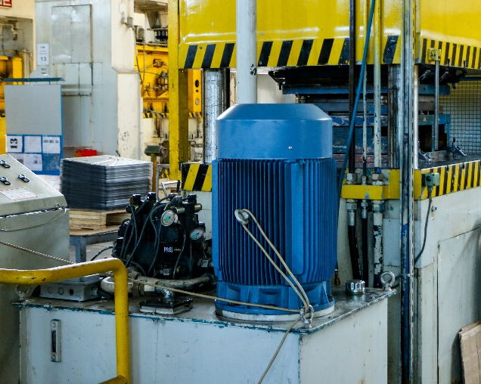

Lessons Learned
The market transformation requires
  a major awareness raising campaign conducting by all stakeholders in the industrial sector.
  strengthening of the capacity of the members in the value chain.
Not only motors but also all of each components in the motor driven systems contribute the energy efficiency therefore integrated approach is necessary for higher efficiency.

Slide 13
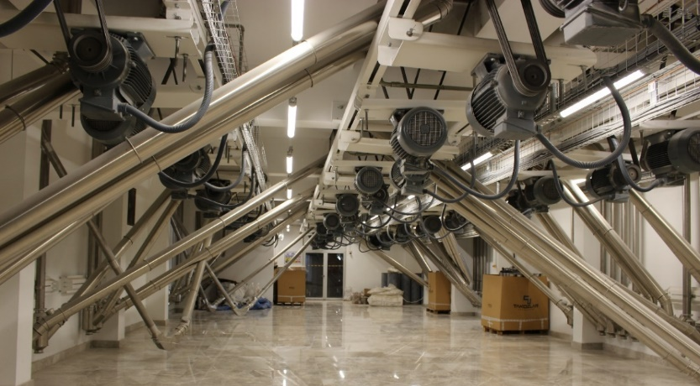
Lessons Learned
Legislation and enforcement will support the trends of energy efficiency investments positively.
A sustainable and feasible financial mechanism designed in accordance with the needs and requirements of the beneficiaries is essential and more encouraging for energy efficiency activities.
A compreherensive database is a valuable tool to monitor and evaluate the market as well as set and revise targets and policies.

Slide 14



Thank you
sezen.torun@sanayi.gov.tr

